Slide 1
Emerging Technologies
Chapter Four
Internet of Things (IoT)

Slide 2
Outline
Overview of IoT
How Does It Work?
IoT Tools and Platforms
Applications of IoT
Notes:
First definitions of IoT will be given.
We will discover the architecture of IoT and observe how it works.
We shall discuss IoT tools and platforms to get an idea so that we may take part as a developer.
Quality of service is particularly important when the system is dealing with time critical data such as sound or video streams.

Slide 3
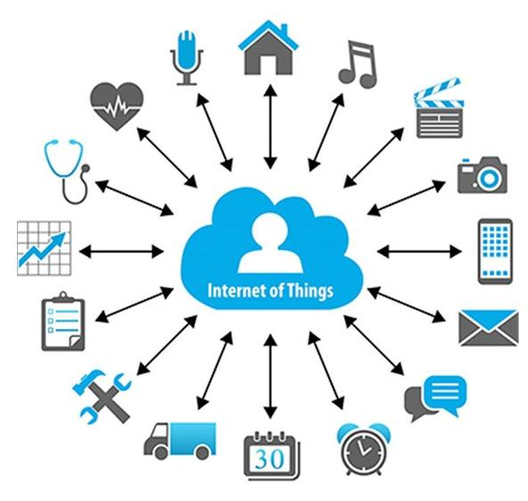
Learning outcomes
After completing this chapter, you should be able to:
Describe IoT
Describe the pros and cons of IoT
Explain how IoT works
Explain the architecture of IoT
Describe application areas of IoT
Notes:
What does this picture stand for?
What are the things in this picture?

Slide 4
Internet of Things (IoT)
Extending the current Internet and providing connection, communication, and inter-networking between devices and physical objects, or "Things," is a growing trend that is often referred to as the Internet of Things.
“The technologies and solutions that enable integration of real world data and services into the current information networking technologies are often described under the umbrella term of the Internet of Things (IoT)”
Notes:
Here are some definitions of IoT.
Data can be fed to AI services, for example, according to the second definition.
Integration: addition, assimilation.
[Q] What is in communication? What do we mean by it?
There is exchange of data.

Slide 5
Internet of Things (IoT)
Definition: Where Internet connectivity becomes expanded to everyday devices such as cars, home appliances, clothes, city infrastructure, and medical and healthcare devices.
One example of rapidly growing industry IoT: autonomous or driverless cars.
IoT devices cut across industries. Their interconnection forms systems typically described as “smart houses”, “smart cities”, and eventually “smart countries”.
Notes:
Thus, IoT is connectivity between things and the collection and exchange of data between devices and systems.
[Q] What does smart signify here in IoT perspective?
In the smart part is connectivity and seamless exchange of real-time data to take immediate actions and to provide efficient services to users of the smart thing.

Slide 6
Internet of Things (IoT)
Definition: Where Internet connectivity becomes expanded to everyday devices such as cars, home appliances, clothes, city infrastructure, and medical and healthcare devices.
One example of rapidly growing industry IoT: autonomous or driverless cars.
IoT devices cut across industries. Their interconnection forms systems typically described as “smart houses”, “smart cities”, and eventually “smart countries”.
Notes:
[Q] How can you relate AI, Big data, and IoT?

Slide 7
Interplay between AI, Big Data and IoT
Key interplay between:
AI: Data-based learning
Big data: Capture, storage, analysis of large volume of data
IoT: Data collection through network of things
Data collected by IoT sensors contributes to building large pools of data (big data) which, in turn, can be processed and used for the development of ML and AI.
IoT = Data + Sensors + Networks + Services
Notes:
In the IoT equation, Services represent cloud computing (distributed computing), platform services, AI and other applications.
For example, data as a service can be provided by IoT through cloud services.
And I agree with the module explanations, and I accept the argument of Meklit of section B.
Regarding, for example, the gateways. Thus, gateways (networking devices) and AI are components of IoT architecture.
IoT architecture in which we are going to see later.
Interplay: The way in which two or more things affect each other.
ML: machine learning.

Slide 8
Things
Things are objects of the physical world (physical things) or of the information world (virtual world) which are capable of being identified and integrated into communication networks. Things have associated information, which can be static or dynamic.
Notes:
Physical world: The world around us which we are collecting data from (sensing).
[Q] How can things in IoT be connected and uniquely identified?
The practical and feasible way is using WSN and RFID.
[Q] Can you suggest the static and dynamic information that can be associated to things in IoT?
Static: Their Id, possibly their position (location) if they are fixed at one place.
Dynamic: Their sensors data.

Slide 9
Things
Physical things exist in the physical world and are capable of being sensed, located, actuated and connected.
Virtual things exist in the information world and are capable of being stored, processed and accessed.
Notes:
Examples of physical things include the surrounding environment, industrial robots, goods and electrical equipment.
Examples of virtual things include multimedia content and application software.
[Q] According to the definition of physical things, what should be the essential components of IoT devices?
Microcontrollers, sensors, and RF antennas might be embedded in IOT devices.
In addition devices can be outfitted with identification (RFID tags) and positioning devices and endowed with an IP address to become smart objects.

Slide 10
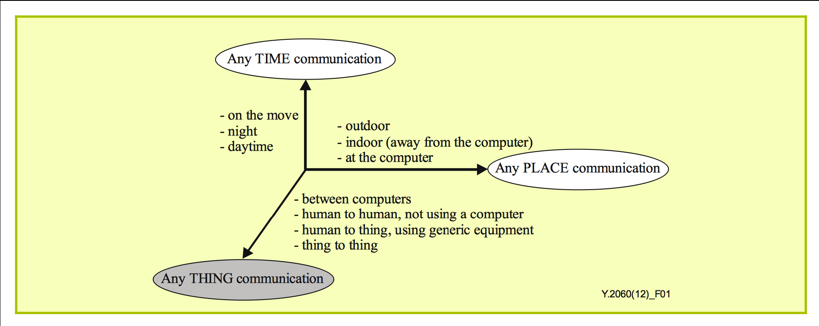
Any-Time/Place/Thing
Notes:
The vision underlying the Internet of things will allow information to be accessed "anytime“, "anywhere" with "anything".
This will be facilitated by using WSNs and RFID tags.
Why WSN? WSN: Wireless Sensor Node and Wireless sensor networks.
WSNs are one of the building blocks of IoT.
Any time, any place (or any where), anything communications is one of the characteristics of IoT.

Slide 11
Why should you learn about IoT?
Emerging technology
Growing IoT Services and Applications in various areas including smart cities, healthcare, transport, logistics, retail, safety and security, etc.
Business trends and new opportunities
Notes:
IoT is an emerging technology and will affect everyone.
Growing IoT Services and Applications and a lot of opportunities.

Slide 12
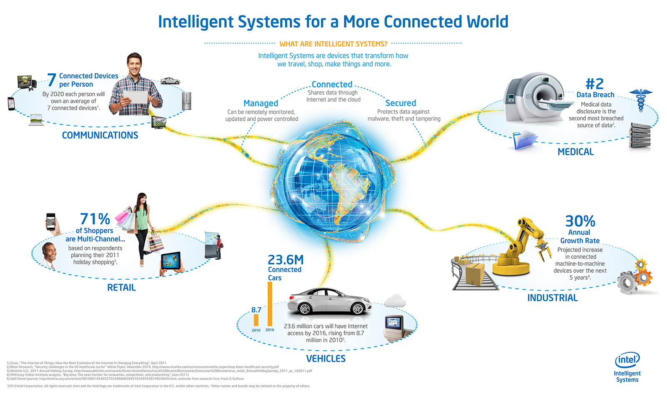
Opportunities
Notes:
Intelligent systems are devices that transform how we travel, shop, make things and more.
A lot growth in connectivity therefore lots of opportunities.
Communications: By 2020 each person will own an average of 7 connected devices.
Retail: 71% of shoppers are multi channel (the anything part).
Vehicles: Tens of millions of cars have internet access.
Industrial: 30% annual growth rate in connected machine to machine devices in the coming years.
Medical data disclosure is the second most breached source of data. Thus, IoT has security concerns.

Slide 13
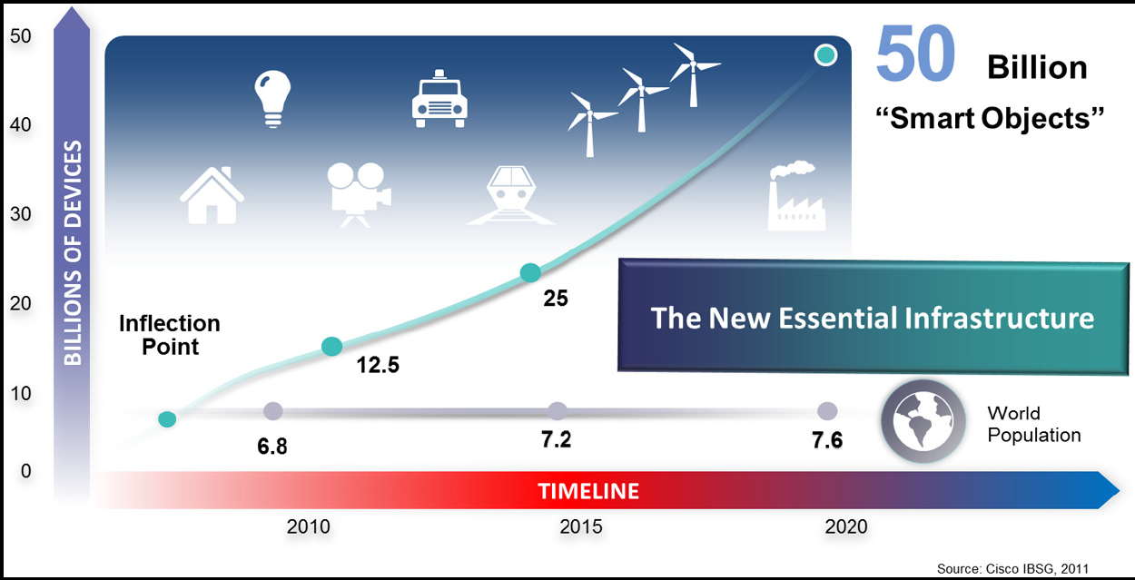
Internet-connected devices and the future evolution (Source: Cisco, 2011)
Notes:
The IoT is the new essential infrastructure.
IoT and Internet are not the same thing. Internet by itself is a world wide network infrastructure.

Slide 14
More IoT Definitions
A network of connected devices
1) With unique identifiers in the form of an IP address and other addressing and tracking techniques, and
2) Which have embedded technologies or are equipped with technologies that enable them to sense, gather data and communicate about the environment in which they reside and/or about themselves.
Notes:
How can devices be uniquely identified? How can devices or people be tracked?
Through IP addresses and RFID tags. A good example of common and practical use of RFID is in car door and steering wheel locks.
Previously we have seen what the drivers or enablers of AI are. [Q] What are they?
In the same way we can ask the following question:
[Q] What are the enablers or drivers of IoT?
IoT is being enabled or driven by miniaturization, wireless connectivity technologies, and increased data storage and processing capacity.

Slide 15
Definition of IoT as a foundation and enabler
IoT is an umbrella term which describes a multi-faceted foundation for a range of applications and goals which are enabled through the connection of items (devices, sensors, tagged beings), equipped with data capture and communication capabilities, uniquely identifiable and connectable, in order to transmit and/or receive data for a clear human, business or societal purpose.
Notes:
Umbrella: a term (technology) that contains many different elements (technologies) or parts.
[Q] How can a computer be uniquely identified in a LAN from a different network in the internet?
[Q] Can you associate this to IoT networks?
How can a node (Wireless Sensor Node), a device or a thing be uniquely identified from the Internet?

Slide 16
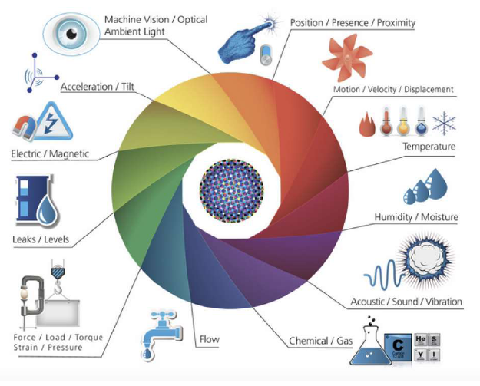
What is to be sensed in IoT?
Notes:
Properties of the environment to be sensed in IoT.
In which we can see the many types of sensors used in IoT.
Thus, IoT has numerous applications.

Slide 17
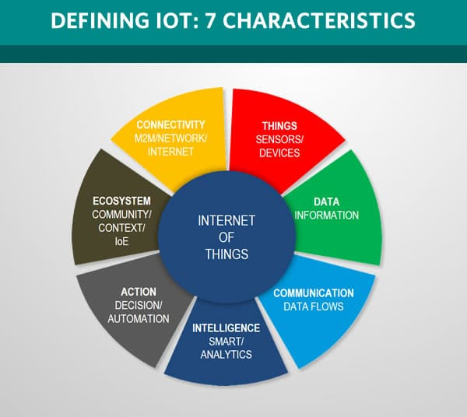
Notes:
Defining IoT with 7 characteristics.
Ecosystem: The IoT ecosystem includes People, the environment, and other systems (system of systems).
IoE: Internet of everything, animate, inanimate and virtual things.

Slide 18
There are 7 crucial IoT characteristics:
1. Connectivity. With everything going on in IoT devices and hardware, with sensors and other electronics and connected hardware and control systems there needs to be a connection between various levels.
2. Things. Anything that can be tagged or connected as such it’s designed to be connected. From sensors and household appliances to tagged livestock. Devices can contain sensors or sensing materials can be attached to devices and items.
Notes:
What do we mean by tagged? What do you think designed to be connected mean?
They have transceivers embedded in or tagged to the devices.
Let me explain Connectivity and Things in the following slides, and then will continue to other IoT characteristics.
So, we shall discuss the anatomy of Things and Connectivity.

Slide 19

Connectivity: WSN
A Wireless Sensor Network is a self-configuring network of small sensor nodes communicating among themselves using radio signals, and deployed in quantity to sense, monitor and understand the physical world.
Wireless Sensor nodes are called motes.
Notes:
Wireless Sensor Networks are built from numerous Wireless Sensor Nodes.

Slide 20
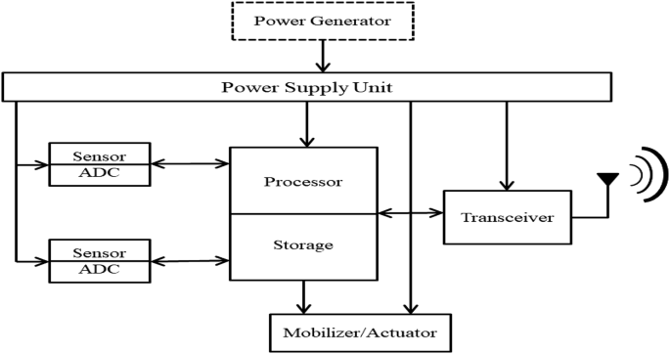
Connectivity: Mote Anatomy
Notes:
The Internal Organization of a Wireless Sensor Node.
[Q] What would be the practical power generator or power supply unit for this device?
Solar panel or AA size small batteries, or coin batteries.
[Q] What is the need for ADC?
[Q] What is a Transceiver?
[Q] What about unique identification? We need to tag it with RFID.
To drive an actuator we may use DAC.

Slide 21
Mote (WSNode) Anatomy
Processor in various modes (sleep, idle, active)
Power source (AA or Coin batteries, Solar Panels)
Memory used for the program code and for in-memory buffering
Radio used for transmitting the acquired data to some storage site, and also the other way
Sensors for temperature, humidity, light, etc
Notes:
[Q] What is the meaning and advantage of the processor being in different modes?
The processor need not to be active all the time. Why?
Most of the time in sleep mode, controlled by a piece of code in memory.
When processor is in sleep or idle mode, that is the case most of the time, battery power is saved.
WSN devises are designed to collect data periodically. For example, once a day.
The device can be turned on and off and/or controlled remotely.

Slide 22
Connectivity: Mote Anatomy
These motes are highly constrained in terms of
Physical size, CPU power, Memory (few tens of kilobytes), Bandwidth (Maximum of 250 KB/s, lower rates the norm)
Power consumption is critical
If battery powered then energy efficiency is paramount
Batteries might have to last for years
May operate in harsh environments
Challenging physical environment (heat, dust, moisture, interference)
Notes:
[Q] Why are the wireless sensor nodes highly constrained in all the terms given above?
To make them very small, to make them use less energy, thus making them convenient to be deployed in large quantities.
To massively deploy them over large areas.

Slide 23
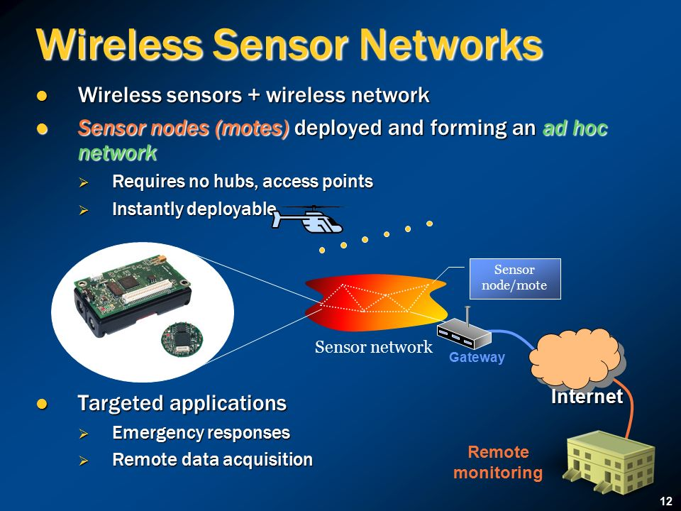
Notes:
Wireless sensor networks = Wireless sensor nodes + Wireless network protocol (software).
Wireless sensor networks may or may not require hubs, depending on the design or topology.
Ad hoc: created or done for a particular purpose as necessary.
[Q] What is a gateway?
MQTT: message queuing telemetry transport.

Slide 24
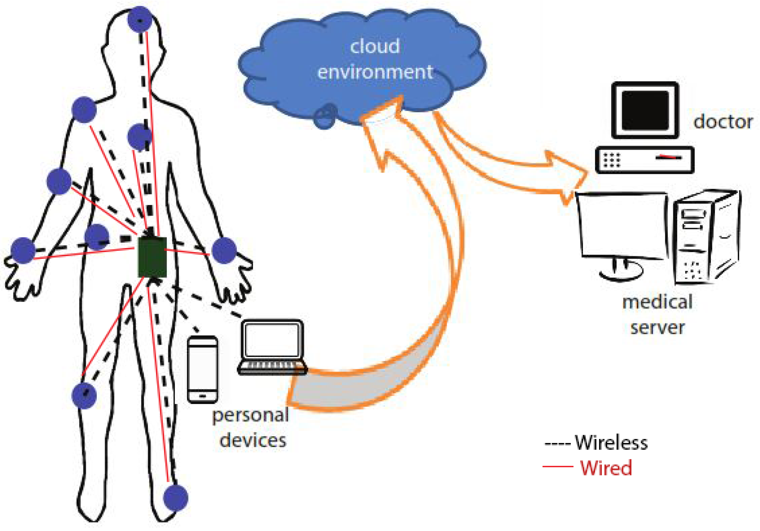
Body Sensor Networks
Notes:
Body sensor networks are one type of IoT.
[Q] Can you identify the wireless sensor nodes, hub, and gateways in this network?
This is a typical example of IoT. With cloud services and medical application in real time use (diagnosis).

Slide 25
There are 7 crucial IoT characteristics:
3. Data. Data is the glue of the Internet of Things, the first step towards action and intelligence.
4. Communication. Devices get connected so they can communicate data and this data can be analyzed. Communication can occur over short distances or over a long range to very long range. Examples: Wi-Fi, and LoRa.
5. Intelligence. The aspect of intelligence as in the sensing capabilities in IoT devices and the intelligence gathered from big data analytics (also artificial intelligence).
Notes:
Here, according to 5, intelligence (big data analytics and AI) is gathered from external sources, or gathered from AI cloud services.
Therefore, pay attention to the two types of intelligence gathered from sensors which is not AI and internal, and
Intelligence gathered from external sources (data analytics & AI, gathered through services and/or APIs).
MQTT: Message queuing telemetry transport, a standard messaging protocol for IoT.
SMS can also be used for communication (messaging).

Slide 26
There are 7 crucial IoT characteristics:
6. Action. The consequence of intelligence. This can be manual action, action based upon debates regarding phenomena (for instance in smart factory decisions) and automation, often the most important piece.
7. Ecosystem. The place of the Internet of Things from a perspective of other technologies, communities, goals and the picture in which the Internet of Things fits. The Internet of Everything dimension, the platform dimension and the need for solid partnerships.
Notes:
Ecosystem: the complex network and/or interconnected systems (Sine-Mehedar).
Ecosystem: The IoT ecosystem includes People, the environment, and other systems (system of systems), SW & HW.
IoE: Internet of everything, animate, inanimate and virtual things.

Slide 27
Reading Assignment: The Following topics are left as a reading assignment for you.
History of IoT
Advantages, Disadvantages, and Challenges of IoT

Slide 28
The key components of an IoT deployment from a high-end perspective are:
The environment (sensing and data capture, in some cases analysis at the edge).
Connectivity within the endpoint environment where data from sensors and to actuators are transmitted and received in hubs (or gateways).
Connection with the cloud and applications, in some cases middleware, called IoT platforms.
The actual outcomes in the form of the end customer application and/or process integration/automation and/or services.
Notes:
Analysis at the edge: Analysis of data at the gateways and within smart objects.
What is the advantage of analysis (or processing) at the edge? Increased performance.
Edge or Fog computing.
Here we can clearly see the four layers of IoT architecture.

Slide 29
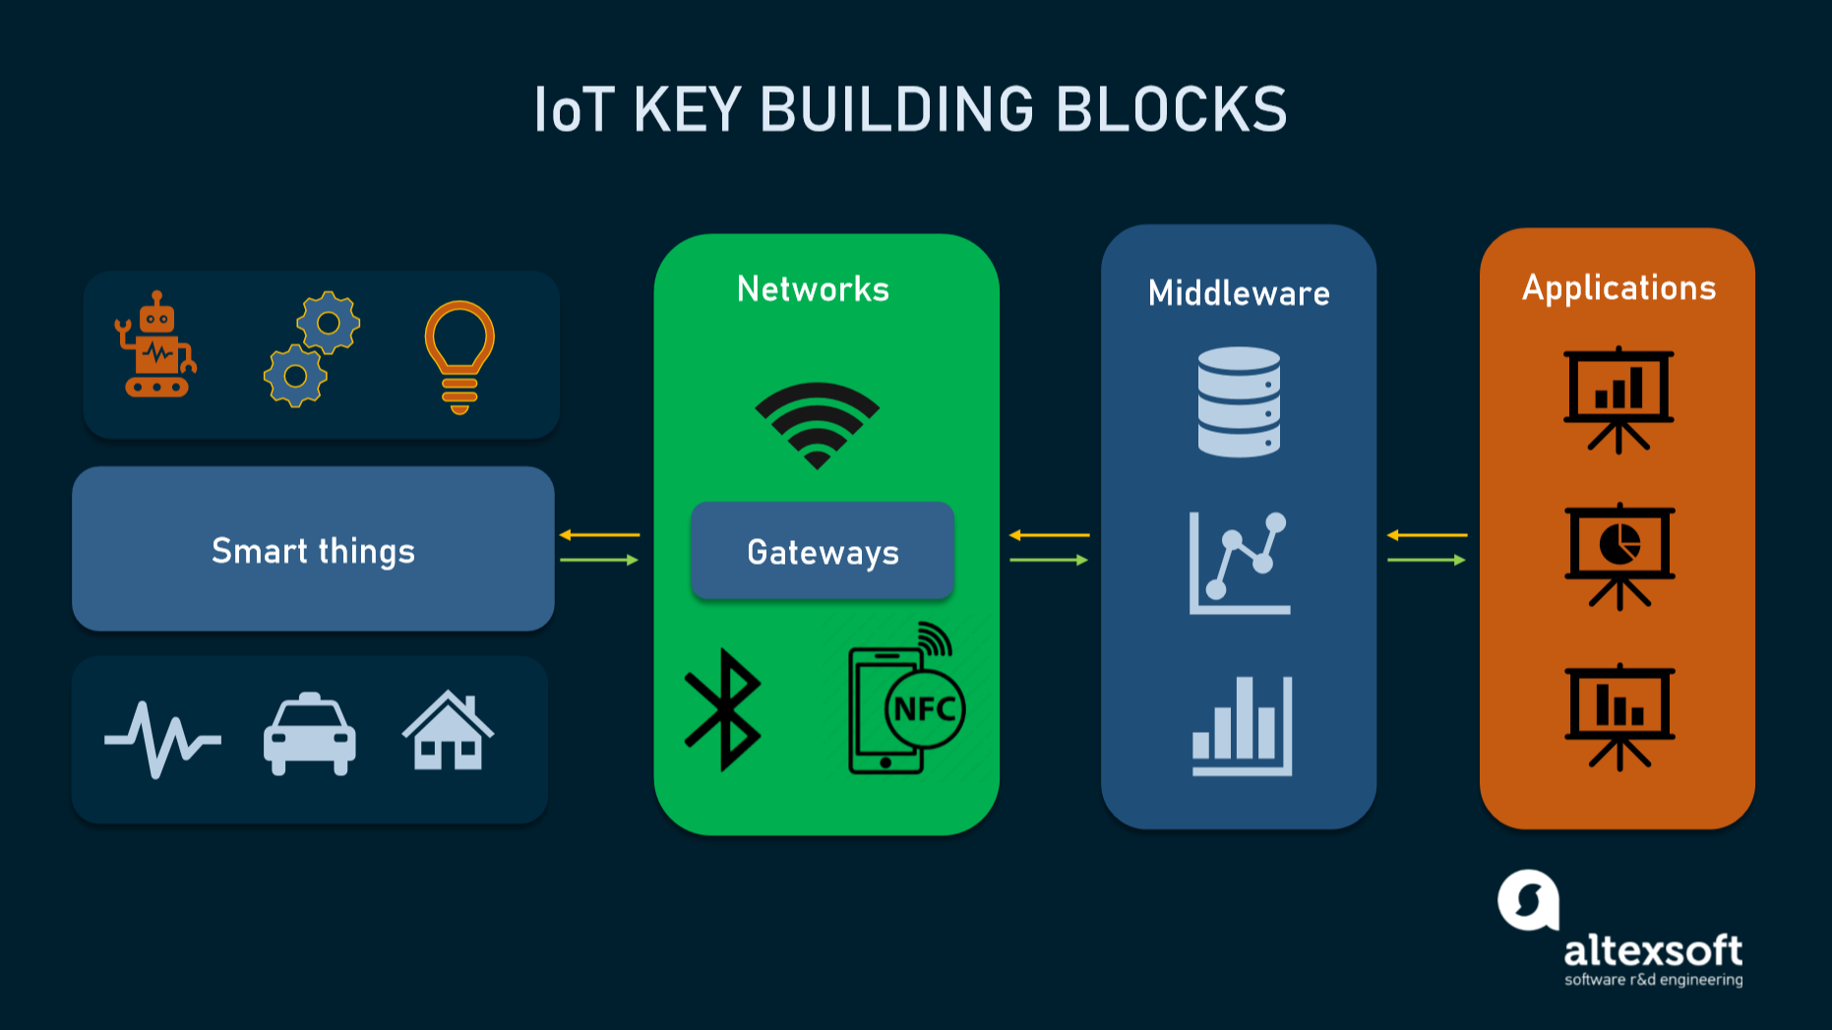
Notes:
Smart things are end points where sensors and actuators are located.
Smart things and networks represent the edge in this picture.
For example Tesla can troubleshoot car problems through IoT, remotely.
The middleware is where data analytics, AI, and many other services are residing.
Applications layer is where customers and end users are served with decision support information.

Slide 30
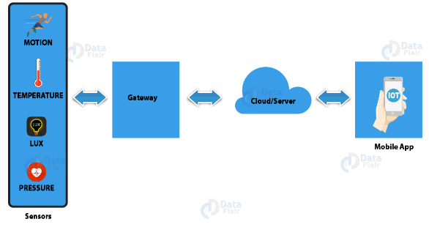
How IoT works?
IoT devices share the sensor data they collect by connecting to an IoT gateway or another edge device where data is either sent to the cloud to be analyzed or analyzed locally.
Notes:
What do we call local analysis?
Edge computing, or fog computing.

Slide 31
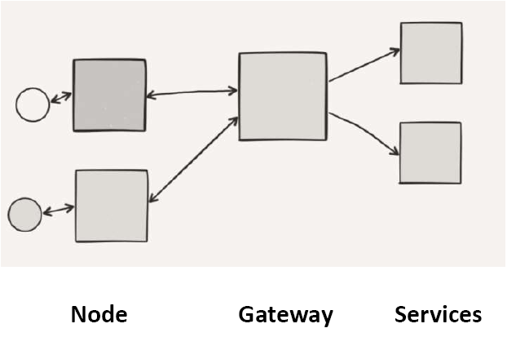
IoT Architecture
SMS, WiFi, LoRa, MQTT
Sensor
Protocol
Protocol
Notes:
Services can be Graphing, Machine Learning, Alerting, etc.
Services can be platform services (Cloud Services).
Heterogeneity is supported by services. Any device using any HW/SW can exchange messages with any other device.
Procedure Oriented (Procedural Programming)→ Object Oriented (OOD,OOP)→ Component Oriented (CORBA)→ Service Oriented (SOA)
Low Level Abstraction ←→ High Level Abstraction, Homogeneity ←→ Heterogeneity
MQTT: Message queuing telemetry transport, a standard messaging protocol for IoT.
SMS can also be used for communication (messaging).

Slide 32
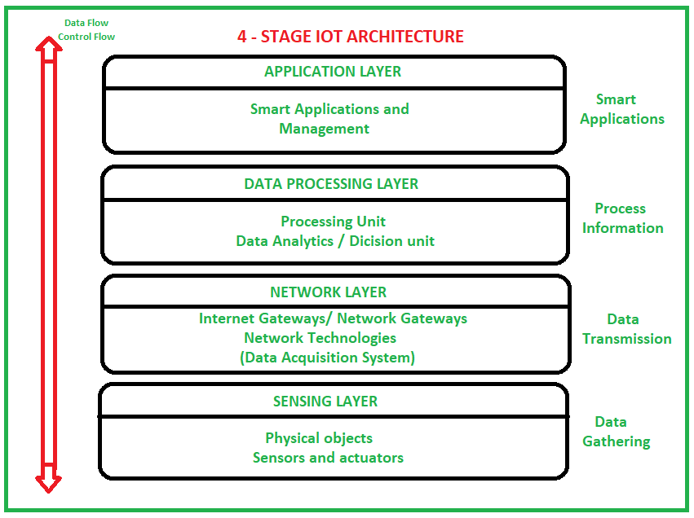
Notes:
[Q] Can you identify (pinpoint) directions of dataflow and control flow.
Control direction is top down, while dataflow is bottom up.

Slide 33
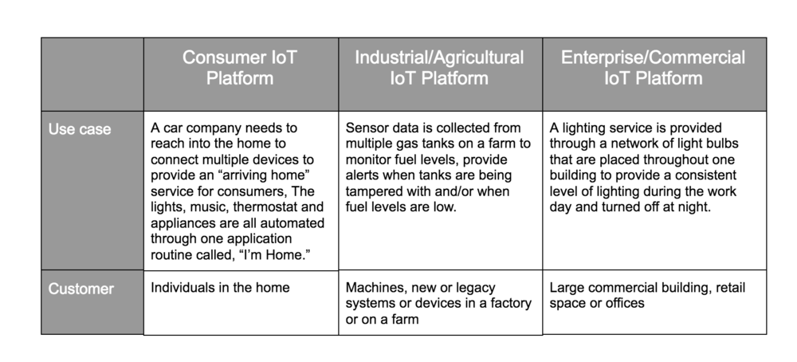
Devices and Networks
consumer, enterprise and industrial IoT
Notes:
IoT devices are meant to work in concert for people at home, in industry or in the enterprise.
As such, devices of IoT can be categorized into three main groups: consumer, enterprise and industrial. Page 72 of module.
This one is about device categorization and case of use.
The second discussion in this section is about Network & Device Management Platform for IoT.
The source article in which excerpts are given in the module is uploaded on githb/abedris. Read the article, and it is an assignment.

Slide 34
IoT Tools & Platforms
There are many vendors in the industrial IoT platform marketplace, offering remarkably similar capabilities and methods of deployment.
IoT Platform | Key Features (Services)
KAA | Manage an unlimited number of connected devices Set up cross-device interoperability Perform real-time device monitoring Perform remote device provisioning and configuration Collect and analyze sensor data Analyze user behavior and deliver targeted notifications Create cloud services for smart products
Notes:
These IoT Platform Solutions are based on the Internet of Things and cloud technology.
They can be used in areas of smart home, city, enterprise, home automation, healthcare or automotive industry, just to name a few.
Kaa is a 100% open-source middleware platform for developing and managing complete end-to-end IoT solutions, connected applications, and smart products. Kaa provides a feature-rich toolkit for IoT product development and dramatically reduces associated costs, risks, and time-to-market.
As said many times, tools and platforms make developers life easy.

Slide 35
IoT Tools & Platforms
The most important services offered by an IoT cloud platform are application development, device management, system management, heterogeneity management, data management, tools for analysis, deployment, monitoring, visualization, and research.
All the computing resources offered by an IoT Platform can be rapidly provisioned and released with minimal management effort or service provider interaction
Notes:
Source: @@Report Daniel Toran
Provision & Release: Analogous to Allocate and Deallocate in computer programming.
[Q] How do you do that in Java?

Slide 36
IoT Tools & Platforms
Briefly discuss the IoT development tools listed below. All ten of them. (Activity 4.8, page 76 of module).
Tessel 2 Eclipse IoT Arduino PlatforIO IBM Watson | Raspbian OpenSCADA Node-RED Kimono Create Device Hive
Notes:
This is a homework for an assigned group.
Next Presentation Subjects. To be given to one group.

Slide 37
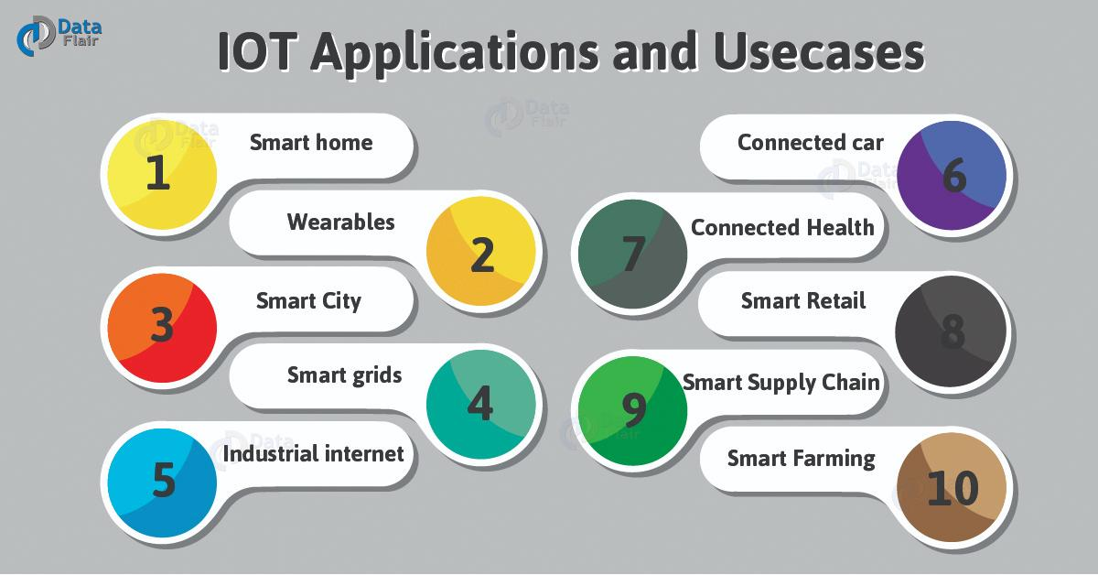
Applications of IoT
Notes:
For more information and examples, read module.

Slide 38
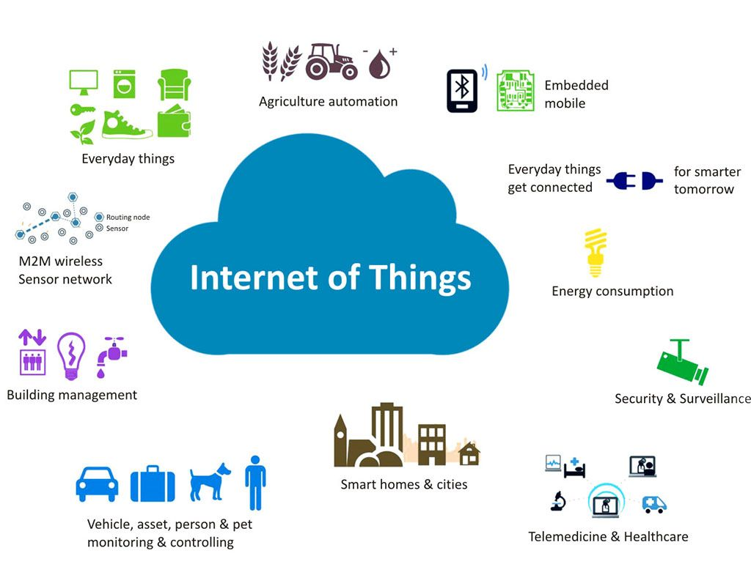
Applications of IoT
Notes:
For detailed information and more examples, read module.

Slide 39
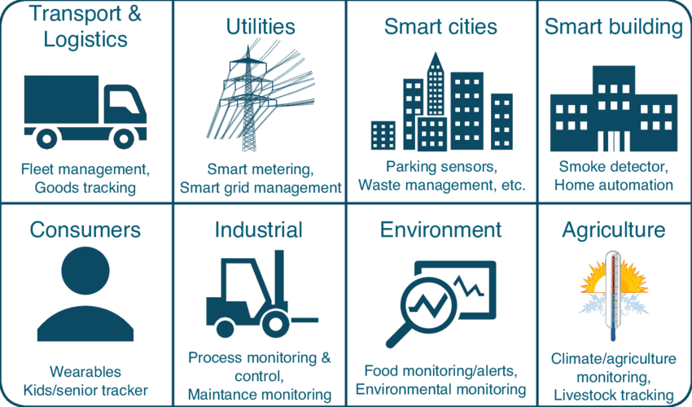
Applications of IoT
Notes:
For more information and examples, read module.

